Slide 1
Mental Math
Write the following words as fractions:
one – half
four – fifths
Write the following fractions as words:
3/4
1/8
81 – 19 =
30 x 7 =
57 + 8 =
1/2
4/5
three – fourths
one – eighths
62
210
65

Slide 2
Starter
Activity: Dice Bingo!

Slide 3

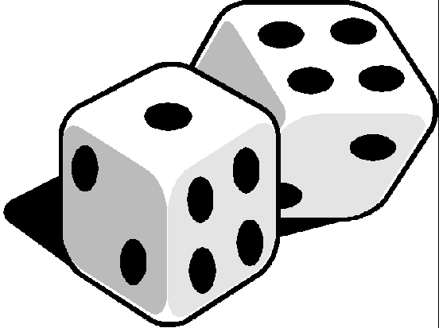
Dice Bingo

Slide 4
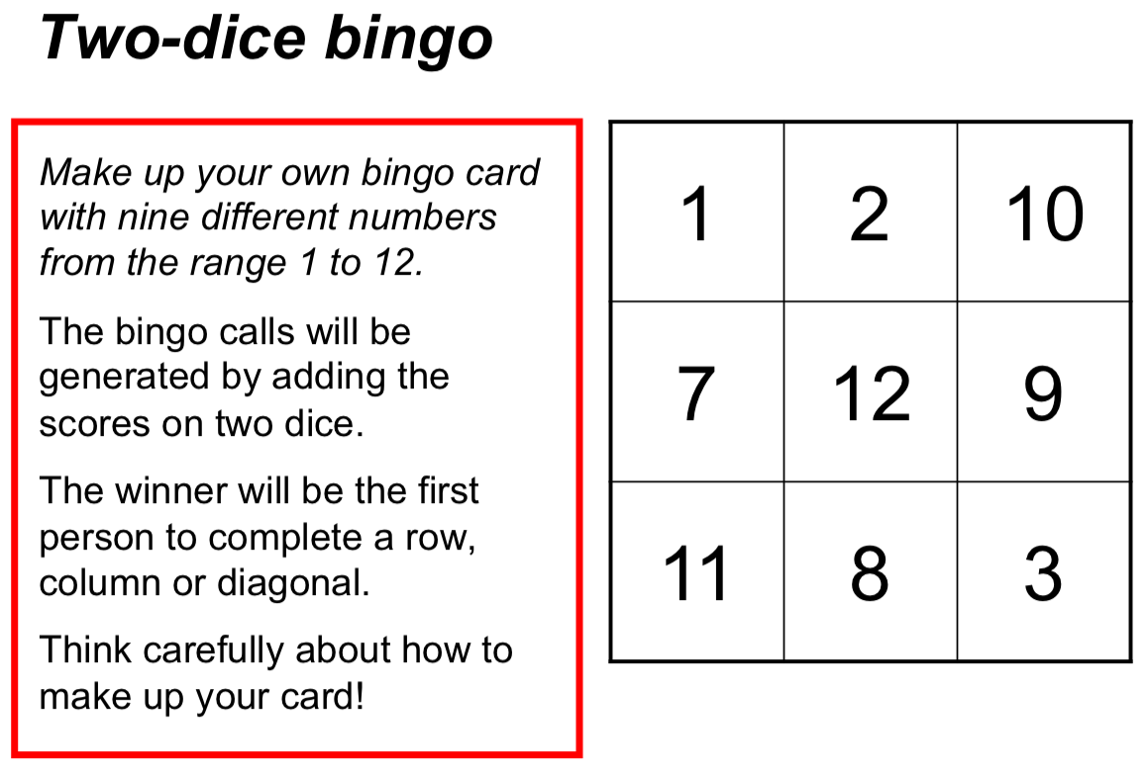
We’re going to play 3 games total!

Slide 5
Discussion
What strategies did you use for making up your bingo card?
What would the ideal Dice Bingo card look like?
Why?

Slide 6
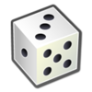
Last Lesson Recap
What is probability?
The probability is word we use to describe chance. The probability of an event is the chance of that event happening between 0 and 1.
What is the probability scale?
A probability scale, starting at 0 (impossible) and ending at 1 (certain).

Slide 7
Topic: Probability
EQ: What is sample space and how do we define it?
What is Sample Space??
A Sample Space is a complete list of all possible outcomes
Example
Tossing a coin: There are two possibilities: heads or tails
The Sample Space is: S = { H, T }

Slide 8
Examples
Sample Space for the toss of a die: S = { 1,2,3,4,5,6 }
Sample Space for choosing a card from a deck
S = {Hearts: 2, 3, 4, 5, 6, 7, 8, 9, 10, j, q, k, A.
Clubs: 2, 3, 4, 5, 6, 7, 8, 9, 10, j, q, k, A.
Spades: 2, 3, 4, 5, 6, 7, 8, 9, 10, j, q, k, A.
Diamonds: 2, 3, 4, 5, 6, 7, 8, 9, 10, j, q, k, A.}
Notes:
• Give students the opportunity to practise with teacher guidance
• Provide immediate and specific feedback with knowledge of results

Slide 9
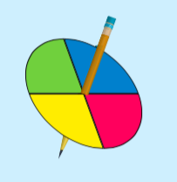
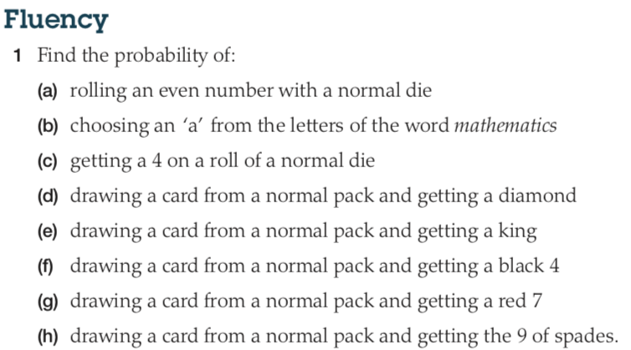
Your Turn
Write the Sample Space for spinning the spinner
Calculate the probability of getting blue.
Calculate the probability of getting yellow.
Notes:
• Practise the skill
• Encouragement

Slide 10
Classwork - Investigation
Probability Dice Game – Fair or Not
Work in pairs

